Slide 1
Forecasting Renewable Energy Consumption With LSTM Models
Under the Guidance DR. YUCHOU CHANG
PREETAM SHANKAR MALLA
STUDENT ID: 02031941

Slide 2
Importance & Challenges of Renewable Energy
Importance:
Renewable energy sources, such as wind and solar, can reduce carbon emissions and air pollution.
Which help to improve public health by reducing respiratory problems and cardiovascular diseases. It is also the more cost-effective than fossil fuels in most parts of the world.
Challenges:
The world continue to face two energy problems: hundreds of millions of people lack access to sufficient energy, and the dominance of fossil fuels in our energy system drives climate change and other health impacts such as air pollution.
One of the key points to stress is the inherent challenge in forecasting renewable energy consumption and production. Renewable energy sources like solar and wind are subject to environmental factors that can change rapidly. This variability introduces significant challenges in ensuring a consistent and reliable energy supply, making accurate forecasting a critical tool for energy planners and policymakers.

Slide 3
LSTM
LSTM (Long Short-Term Memory) networks are a type of RNN (Recurrent Neural Network) specifically designed to learn from sequences of data, making them ideal for time series forecasting.
LSTM networks, with their ability to remember information for long periods, are uniquely suited to address the challenges of time series forecasting in renewable energy. They can model complex patterns in historical data, including seasonal variations and trends, to make predictions about future energy needs.
LSTMs help overcome the vanishing gradient problem, which is a common issue in traditional RNNs where the network becomes unable to learn from data points that are too far apart in time. This capability makes LSTMs particularly effective for forecasting tasks where understanding long-term dependencies is crucial.

Slide 4
Overview of the Dataset
We harvested the data set from ‘Our World in Data’
  https://ourworldindata.org/energy
The dataset contains data concerning energy consumption comprises over 21K entries and 129 columns.
It includes entries for specific countries and certain aggregates like ASEAN, suggesting a mix of national and regional data. The data spans multiple years, starting from at least the year 1990 – 2022.
It also includes data like country, year, population, and GDP, the dataset encompasses a vast array of energy-related metrics. These include changes in biofuel consumption, per capita energy metrics, total energy consumption, electricity generation from various sources (solar, wind, etc.)
There are many missing values (NaN) across different columns in the initial entries, indicating that not all metrics are reported for all countries or years.

Slide 5
Technology Stack
Python: The primary programming language used for implementing data manipulation, model building, and analysis for data science and machine learning libraries.
Pandas: Is a Python library providing high-performance, easy-to-use data structures, and data analysis tools for handling and preprocessing the dataset.
NumPy: Is used for numerical operations on large multi-dimensional arrays and matrices, often used alongside Pandas for data manipulation.
Scikit-learn: Used for data preprocessing steps, particularly for features scaling using the MinMaxScaler to normalize data before feeding it into the LSTM model.
Keras(With TensorFlow Backend): It is a high-level neural networks API, running on top of TensorFlow, used for building and training the LSTM model. Keras simplifies complex neural network constructions.
Matplotlib and Seaborn: These are the Visualization libraries used for plotting.
Google Collab: Is the development environment

Slide 6
Data Preparation for LSTM Model
Dataset Loading: Firstly, we have loaded the dataset using pandas, to import time series data from csv file.
Filtering Data : To forecast renewable energy consumption, we focus on filtering by country selecting ‘renewable_consumption’ column and ensuring there are no missing values.
Normalization: I performed the normalization using the MinMaxScaler from the sklearn. This scaler transforms each feature to a given range, typically (0, 1), ensuring that the LSTM model receives input data within a scale it can effectively work with.
Trasforming time series data: I used ‘Series_to_supervised ’ function to create a structured dataset where the model can learn to predict a future value based on past observations.
Reshaping data: LSTM models in Keras expect input data to have a specific three-dimensional structure, Following transformation into a supervised learning format, the data is reshaped to fit this structure.
Splitting data: Then dataset is split into training and testing sets. This allows the model to learn from one subset of the data and then be evaluated on a separate subset, providing insight into how well the model is expected to perform on unseen data.

Slide 7
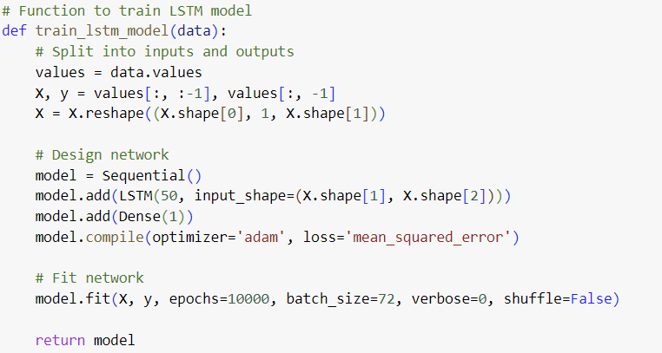
Training Parameters
Epochs: 10,000 – I gave a high number of epochs to ensure thorough learning, though typically, you would monitor for overfitting and possibly employ early stopping.
Batch Size: 72 - Chosen to balance computational efficiency and model performance.
Optimizer: Adam - For efficient computation and adaptive learning rates.
Loss Function: Mean Squared Error (MSE) - Standard for regression problems, aiming to minimize the average of the squares of the errors.

Slide 8
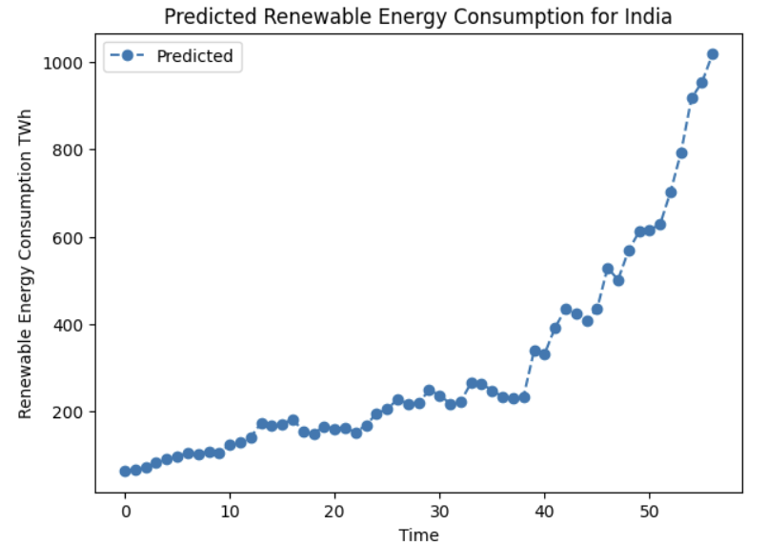
Predicted Energy Consumption for “India”
‘Country_example’ variable specifically set to 'India’.
Retrieves the pre-trained LSTM model and the
MinMaxScaler instance for India from dictionary
called ‘Country_models’. This dictionary stores
models and scalers for each country, allowing for
easy access when performing predictions.
The x- axis represents ‘Time’
The Y-axis represents the energy consumption,
Represents units TWh(terawatt hours)

Slide 9
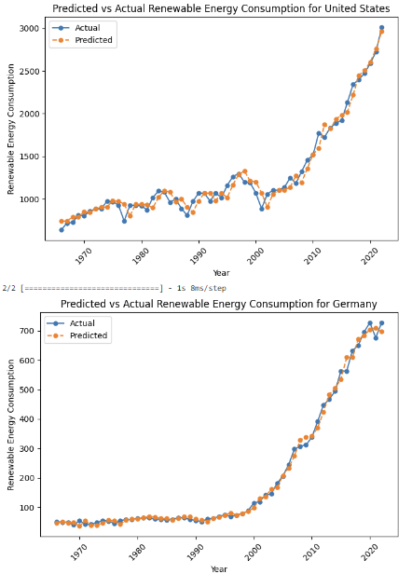
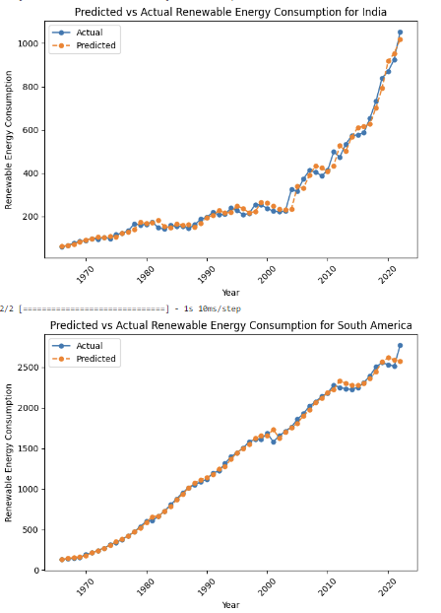
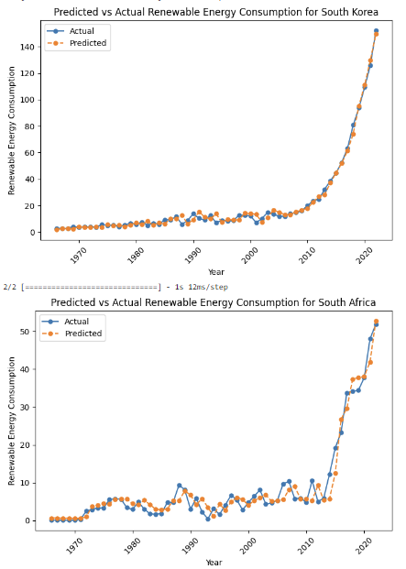
Actual vs Predicted Visualization

Slide 10
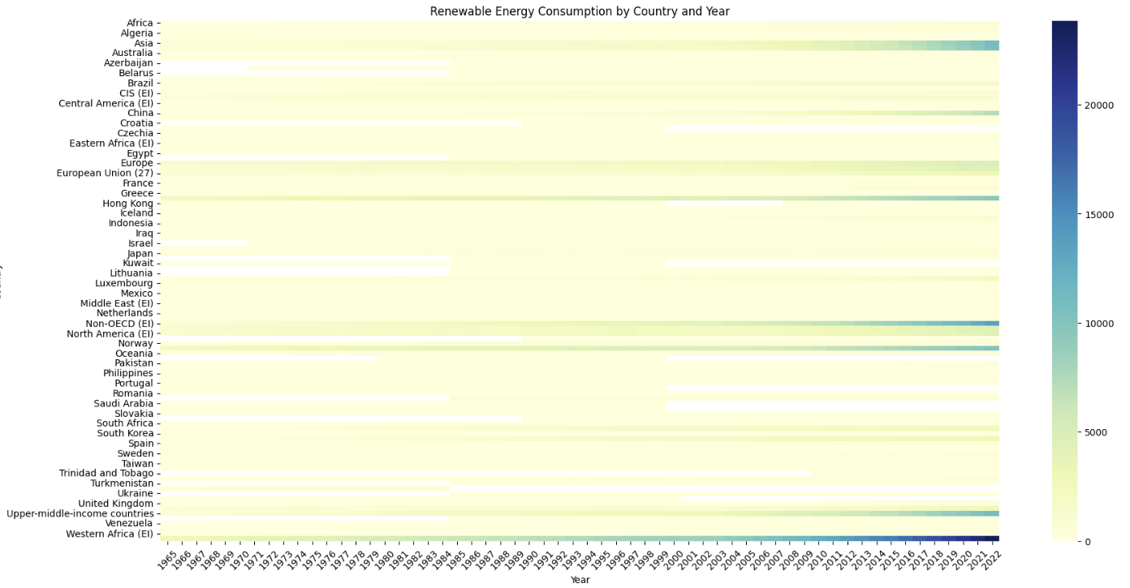
Energy Consumption by Country and Year
This heatmap shows the analysis of renewable energy consumption.

Slide 11
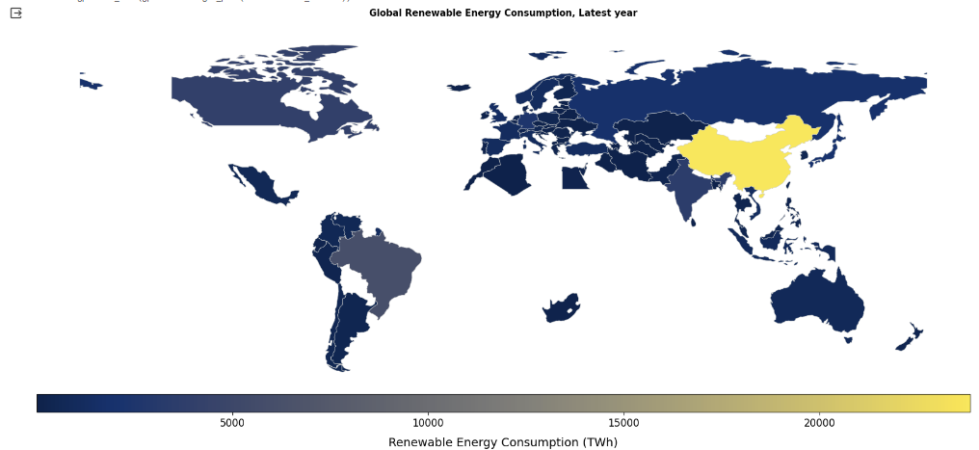
Choropleth Map - Visualization
We aggregate the data by country to calculate the mean renewable energy consumption for each country in the latest year, and then resets the index to make 'country' a column again.

Slide 12
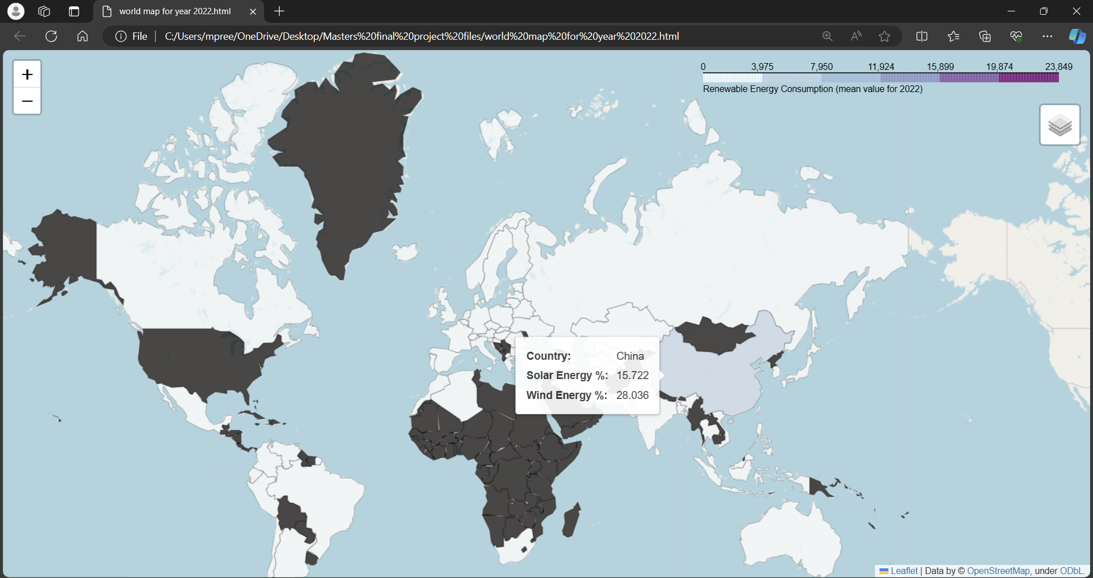
Geographical Mapping
We designed interactive maps, using Folium.
The average contribution of solar and wind to renewable energy by country for the year 2022.

Slide 13
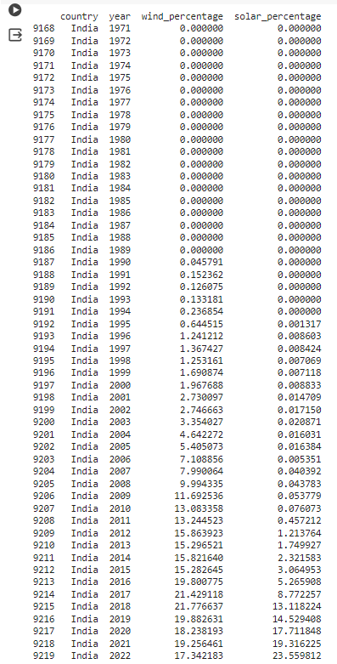
Contribution of Solar and Wind Energy
we consider the solar and wind energy, as renewable energy.
We have the graphs and geospatial maps for average of Renewable energy.
This output shows the percentage of the solar and wind energy contributed
Throughout the years from 1968 to 2022.

Slide 14
Thank You

